Slide 1
Chapter 8
Social Media
Information Systems

Slide 2
“It’s All About Eyeballs”
Repurpose PRIDE to make it more profitable
“Eyeballs” & clicks generates revenue
Will PRIDE handle large number of users?
Need to describe potential to vendors
Carefully think about details of how system will function before estimating development costs or project timeline
Notes:
GOALS
Illustrate how social applications can generate revenue.
Show how cloud-based infrastructure can support social applications.
Consider a unique application of social networking for fitness.
Show the difficulties inherent in the systems development process.
“Eyeballs” refers to number of people that view a piece of marketing collateral.
“Clicks” refers to number of people who click on an ad link.

Slide 3
PRIDE Application Prototype
Generating revenue from social media applications difficult
Not all social media applications involve Facebook or Twitter
It's all marketing
Think about ways of applying new, emerging technology to accomplish business organizational strategies
Notes:
A report with data from a cloud database. Because it is being served from the cloud, it is accessible by doctors, patients, health clubs, employers, insurance companies, and others who are not yet known to be involved

Slide 4
Study Questions
Q1: What is a social media information system (SMIS)?
Q2: How do SMIS advance organizational strategy?
Q3: How do SMIS increase social capital?
Q4: How do (some) companies earn revenue from social media?
Q5: How can organizations address SMIS security concerns?
Q6: Where is social media taking us?
How does the knowledge in this chapter help you?
Notes:
Best response to rapid technological change is to learn and understand underlying principles.
Focus on principles, conceptual frameworks, and models that will be useful to address the opportunities and risks of social media systems in early years of your professional career.
The important question is what’s the purpose for having a social media presence? To be modern? To be hip? And do they have a social media strategy? Will using social media affect their bottom line?

Slide 5
Q1: What Is A Social Media Information System (SMIS)?
Social media (SM)
IT to support content sharing among networks of users
Enables communities of practice
People related by common interest
Social media information system (SMIS)
IS for sharing content among networks of users

Slide 6
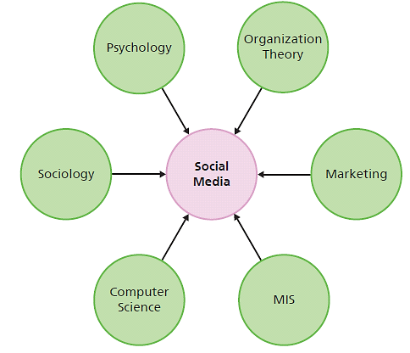
Convergence of Many Disciplines
Notes:
Focus on MIS portion of diagram by discussing SMIS and how they contribute to organizational strategy.
Social media is a convergence of many disciplines.

Slide 7
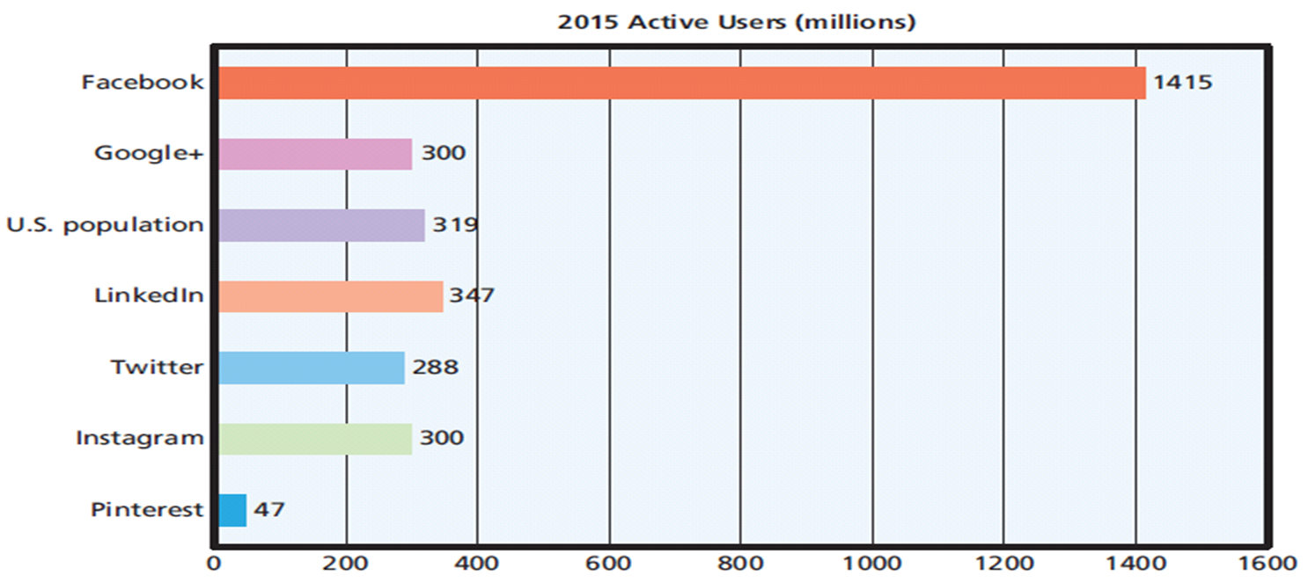
Number of Social Media Active Users
Notes:
73+% of people with Internet access use SM, and 40% access SM via their mobile phones.
77% of Fortune 500 companies maintain active Twitter accounts; 70% Facebook pages, 69% YouTube accounts.

Slide 8
Three SMIS Roles
Social media providers
Facebook, Google+, LinkedIn, Twitter, Instagram, and Pinterest provide platforms
Attracting, targeting demographic groups
Users
Individuals and organizations
Communities
Mutual interests that transcend familial, geographic, and organizational boundaries
Notes:
Over 73% of people with Internet access use SM, and 40% access SM via mobile phones.
68% of Pinterest users are female. 80% LinkedIn users are 35 or older.
Companies hire staff to maintain their SM presence, promote their products, build relationships, and manage their image. Depending on how organizations want to use SM, they can be users, providers, or both.

Slide 9
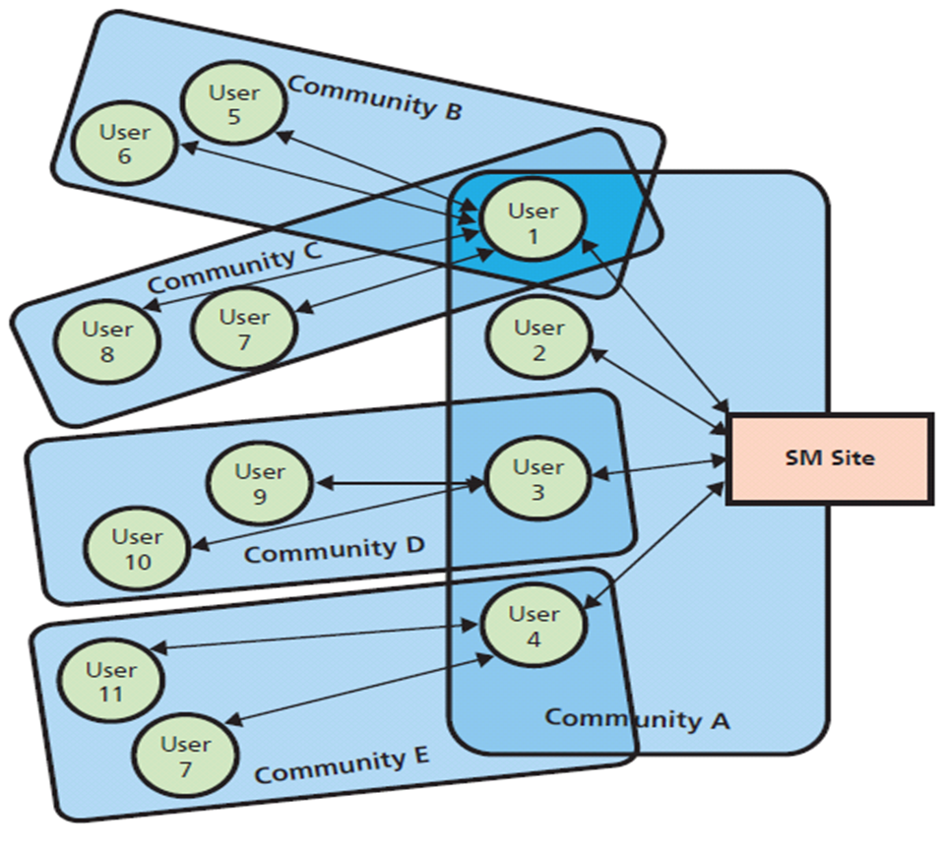
SM User Communities
Notes:
Community A - first-tier community of users with direct relationship to the site. User 1 belongs to three communities — A, B, and C.
Communities B–E - second-tier communities intermediated by a first-tier user.
Number of second and higher tier community members grows exponentially.
Exponential nature of relationships offers sponsoring organizations both a blessing and a curse.
If social media site wants pure publicity, will need viral hook to relate to as many communities as possible.

Slide 10
Social Media Application Providers
Facebook, Twitter, LinkedIn, Google …
Maybe charge fee
Free company page free on Facebook, but ...
Fee to advertise to communities that “Like” that page
Internal SM using SharePoint for wikis, discussion board, photo sharing
Notes:
Larger organizations are big enough to create and manage their own internal social media platforms such as wikis, blogs, and discussion boards. Thus, becoming a social media provider.

Slide 11
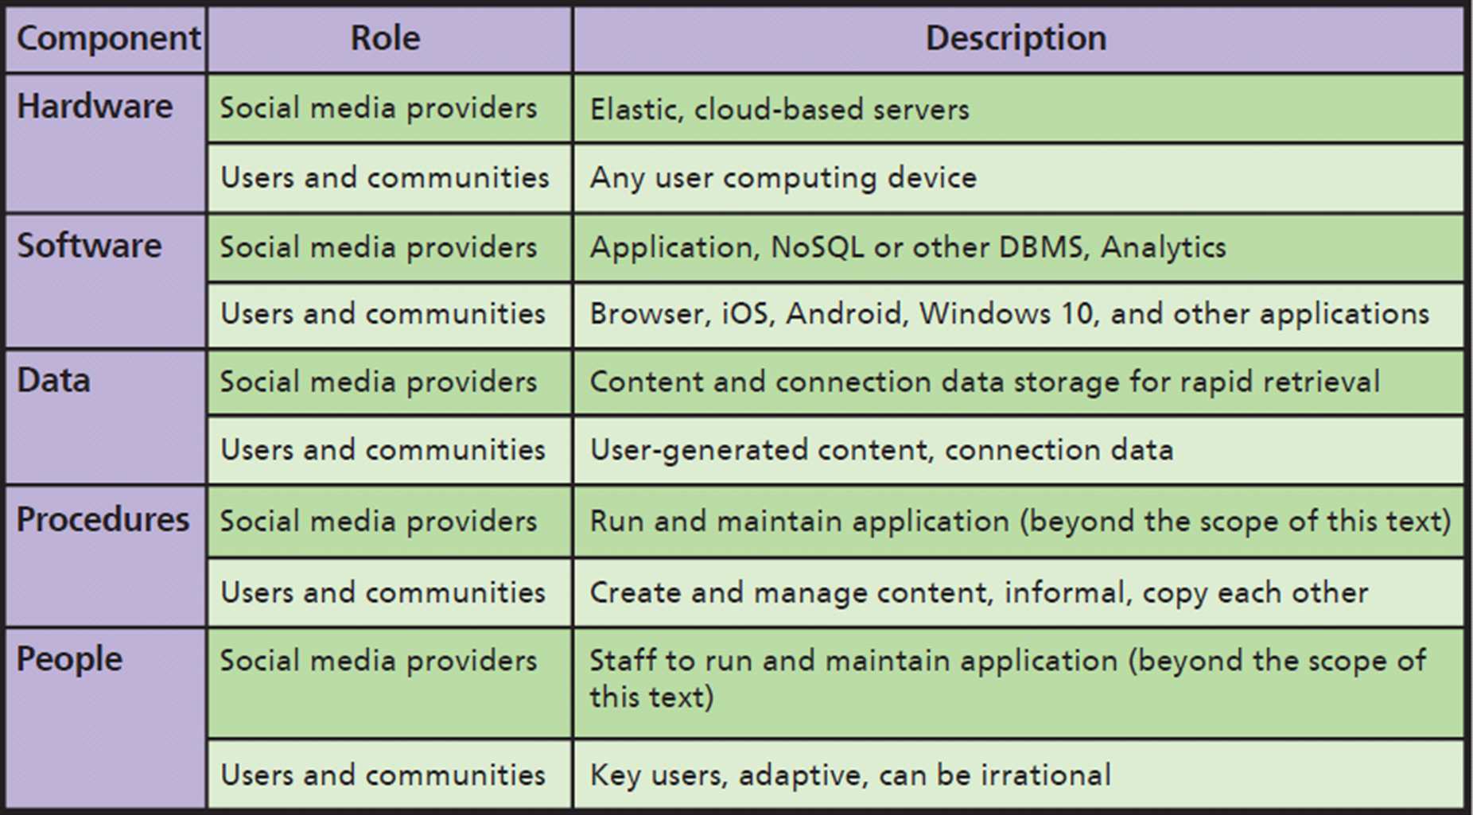
Five Components of SMIS
Notes:
SM application providers host SM presence using elastic servers in the cloud.
Develop and operate custom, proprietary, social networking application software.
Content data - data and responses to data contributed by users and SM sponsors.
Connection data - data about relationships.
Must have procedures for creating content, managing user responses, removing obsolete or objectionable content, and extracting value from content.
Social media creates new job titles, new responsibilities, and need for new types of training.

Slide 12
SMIS Is Not Free
Costs to develop, implement, manage social networking procedures
Direct labor costs
92% use social media to recruit (93% from LinkedIn)
73% hired using social media
One third rejected candidates because of social profile

Slide 13
Q2: How Do SMIS Advance Organizational Strategy?
Strategy determines value chain
Value chains determine business processes
Processes determine SMIS requirements
How do value chains determine dynamic processes?
Dynamic process flows cannot be designed or diagrammed
SM fundamentally changes balance of power among users, their communities, and organizations

Slide 14
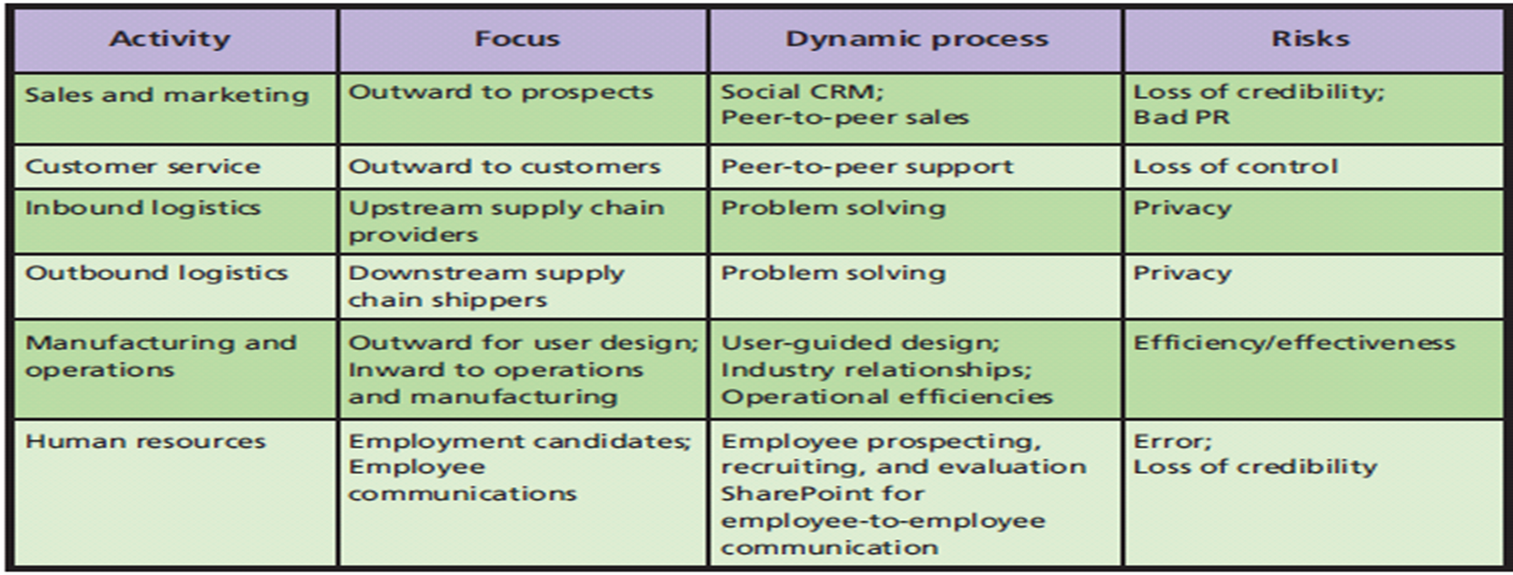
SM in Value Chain Activities
Notes:
This figure summarizes how social media contributes to five primary value chain activities and to human resources support activity.
General framework by which organizations can accomplish their strategy via a dynamic process supported by SMIS.

Slide 15
Social Media and the Sales and Marketing Activity
Dynamic, SM-based CRM process
Social CRM
Each customer crafts relationship
Wikis, blogs, discussion lists, frequently asked questions, sites for user reviews and commentary, other dynamic content
Customers search content, contribute reviews and commentary, ask questions, create user groups, etc.
Not centered on customer lifetime value
Notes:
In the past, organizations controlled their relationships with customers using structured processes and related information systems. In fact, the primary purpose of traditional CRM was to manage customer touches.

Slide 16
Social Media and Customer Service
Relationships emerge from joint activity, customers have as much control as companies
Product users freely help each other solve problems
Selling to, or through, developer networks most successful
Microsoft's MVP program
Peer-to-peer support risks loss of control
Notes:
Amazon's Vine customers provide pre-release and new product reviews to the buyer community.
Many organizations struggle to make the transition from controlled, structured, traditional CRM processes to wide-open, adaptive, dynamic social CRM processes.

Slide 17
Social Media and Inbound and Outbound Logistics
Numerous solution ideas and rapid evaluation of them
Better solutions to complex supply chain problems
Facilitate user created content and feedback among networks needed for problem solving
Loss of privacy
Open discussion of problem definitions, causes, and solution constraints
Problem solving in front of your competitors
Notes:
The Japanese earthquake in the spring of 2011 created havoc in the automotive supply chain when major Japanese manufacturers lacked power and, in some cases, facilities to operate. Social media was used to dispense news, allay fears of radioactive products, and address ever-changing needs and problems.

Slide 18
Social Media and Manufacturing and Operations
Improve communication channels within organization and externally with consumers, design products, develop supplier relationships, and improve operational efficiencies
Crowdsourcing
Businesses-to-consumer (B2C)
Youtube channel to post videos of product reviews and testing, factory walk-throughs
Yammer - enterprise social networking service

Slide 19
Social Media and Human Resources
Employee communications using internal personnel sites
Ex: MySite and MyProfile in SharePoint
Finding employee prospects, recruiting candidates, candidate evaluation
Place for employees to post their expertise
Risks:
Forming erroneous conclusions about employees
Becoming defender of belief or pushing unpopular management message

Slide 20
What Is the Value of Social Capital?
Value of social capital
Number of relationships, strength of relationships, and resources controlled
Adds value in four ways:
Information
Influence
Social credentials
Personal reinforcement
Notes:
Relationships in social networks can:
Provide information about opportunities, alternatives, problems, and other factors important to business professionals.
Provide an opportunity to influence decision makers who are critical to your success.
Be a form of social credentials.
Reinforce a professional’s image and position in an organization or industry.

Slide 21
So What? Facebook for Organizations… and Machines
Chatter, by salesforce.com, to connect employees, customers
Communities identify, solve problems more quickly and more effectively
Readily find and recruit needed experts within organization
Faster project collaboration
Internal-facing communities use social media to make organizations better

Slide 22
Q3: How Do SMIS Increase Social Capital?
Capital
Investment of resources for future profit
Types of business capital
Physical capital: produce goods and services (factories, machines, manufacturing equipment)
Human capital: human knowledge and skills investments
Social capital: social relations with expectation of marketplace returns

Slide 23
What Is the Value of Social Capital?
Benefits to People
Information
Opportunities, alternatives, problems, and other factors important to professionally and personally
Influence
Decision makers and peers
Notes:
People benefit from social capital in four ways

Slide 24
What Is the Value of Social Capital? (cont’d)
Social credentials
Being linked to a network of highly regarded contacts
Personal reinforcement
Professional identity, image, and position in organization or industry
Understand what social capital is, why it’s valuable, and how you can benefit from it
Notes:
People benefit from social capital in four ways

Slide 25
Gain Social Capital for Professionals
By adding more friends and strengthening relationships with existing friends
By adding friends and strengthening relationships with people who control resources important to you
Measure your social networking capital with online service, such as Klout.com
More others respond to your content, higher your score

Slide 26
How Do Social Networks Add Value to Businesses?
Progressive organizations:
Presence on Facebook, LinkedIn, Twitter, and other SN sites
Encourage customers and interested parties to leave comments
Risk - excessively critical feedback

Slide 27
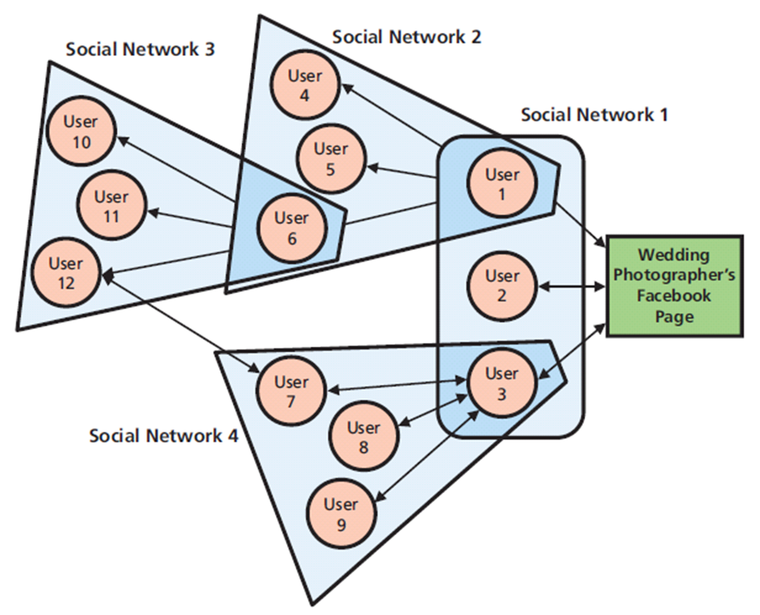
Using Social Networking to Increase the Number of Relationships
Notes:
Organizations have social capital just as humans do.
Discuss how could a photographer use SM to communicate a wedding experience using text, pictures, and video instantly to everyone in your social network,

Slide 28
Using Social Networks to Increase the Strength of Relationships
Strength of a relationship
Likelihood other entity will do something that benefits your organization
Positive reviews, post pictures using organization’s products or services, tweet about upcoming product releases, and so on
Strengthen relationships by asking you to do them a favor
Frequent interactions strengthen relationships
Notes:
You weaken the strength social relationships by continually freeloading, declining requests for help, and failing to spend time with friends.

Slide 29
Using Social Networks to Connect to Those with More Resources
Social Capital = Number of Relationships × Relationship Strength × Entity Resources
Huge network of people with few resources less valuable than smaller network with substantial resources
Resources must be relevant
Most ignore value of entity assets

Slide 30
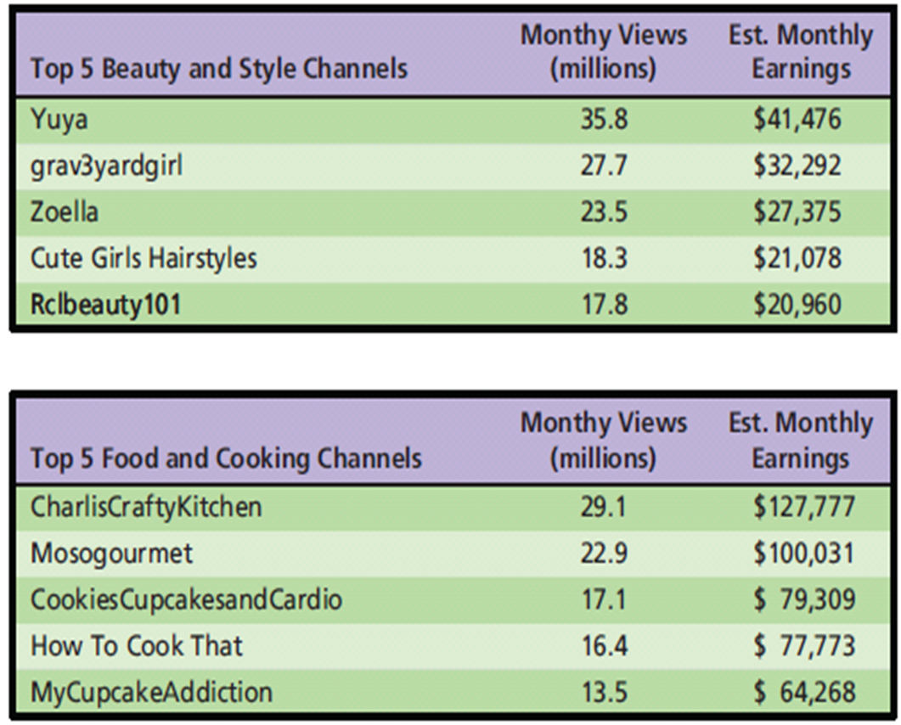
Top YouTube Channels
Notes:
In general, the more views a channel gets, the more the content creator gets paid.

Slide 31
Q4: How Do (Some) Companies Earn Revenue from Social Media?
Hyper-social organization
Use SM to transform interactions with customers, employees, and partners into mutually satisfying relationships with them and their communities
You Are the Product.
“If you’re not paying, you’re the product.”
Renting your eyeballs to an advertiser
Monetize
Notes:
As a business student, you know that nothing is free. Processing time, data communication, and data storage may be cheap, but they still cost something.

Slide 32
Revenue Models for Social Media
Advertising
Pay-per-click
Use increases value
Freemium
Offers users a basic service for free, then charges a premium for upgrades or advanced features
Sales –
Apps and virtual goods, affiliate commissions, donations
Notes:
The two most common ways SM companies generate revenue are advertising and charging for premium services.

Slide 33
Does Mobility Reduce Online Ad Revenue?
Number of mobile devices to reach 10 billion by 2018
Mobile data traffic eleven-fold increase
Average click-through rate of smartphones is 4.12%, but just 2.39% on PCs
Conversion rate
Frequency someone clicks on ad makes a purchase, “likes” a site, or takes some other action desired by advertiser
Notes:
Facebook made 94% of its 2015 first quarter earnings ($3.5B) from advertising. About 90% of Twitter’s $436M.

Slide 34
Does Mobility Reduce Online Ad Revenue? (cont'd)
Paid search, display or banner ads, mobile ads, classifieds, or digital video ads
Use of ad-blocking software growing by 69% per year

Slide 35
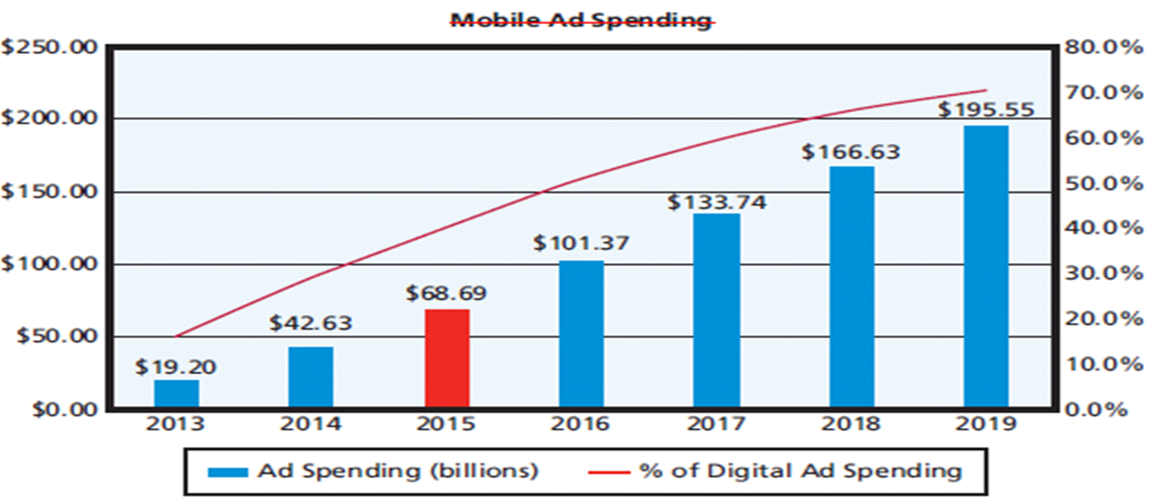
Mobile Ad Spending
Notes:
Mobile users click ads more often and hence generate more revenue.
Design problem: how best to configure the mobile experience to obtain legitimate clicks and conversions.

Slide 36
Q5: How Can Organizations Address SMIS Security Concerns?
Develop and publicize a social media policy
Delineate employees’ rights and responsibilities
Index to 100 different policies at Social Media Today Web site
Intel's Three Pillars of SM Policies
Disclose
Protect
Use Common Sense
Notes:
Organizations and executives no longer plan and control organizational messaging. Such messaging emerges via a dynamic, SM-based process. Ask students what they think about that.

Slide 37
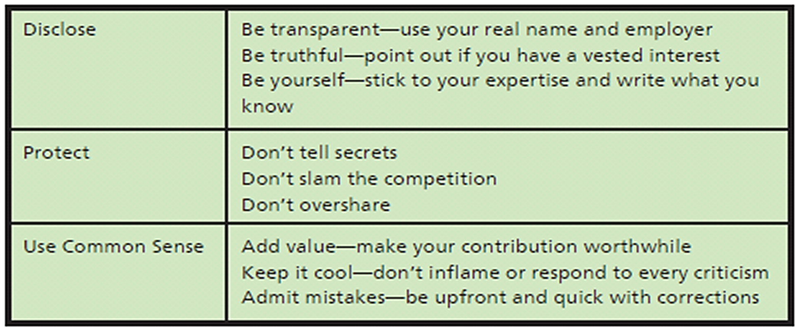
Intel’s Rules of Social Media Engagement
Notes:
Managing the Risk of Employee Communication.

Slide 38
Managing the Risk of Inappropriate Content
User-generated content (UGC)
Problems from external sources
Junk and crackpot contributions
Inappropriate content
Unfavorable reviews
Mutinous movements

Slide 39
Responding to Social Networking Problems
Leave it
Respond to it
Delete it
General rule
“Never wrestle with a pig; you’ll get dirty and the pig will enjoy it.”

Slide 40
Internal Risks from Social Media
Threats to information security, increased organizational liability, decreased employee productivity
Directly affect ability to secure information resources
Innocuous comments inadvertently leak information used to secure access to organizational resources
Bad idea to tell everyone it’s your birthday because your date of birth (DOB), can be used to steal your identity

Slide 41
Internal Risks from Social Media (cont'd)
Employees inadvertently increase corporate liability when they use social media
Sexual harassment liability
Leak confidential information
Reduced employee productivity
64% of employees visit non-work-related Web sites each day
Tumblr (57%), Facebook (52%), Twitter (17%), Instagram (11%), and SnapChat (4%)
Notes:
Smart managers know SM comes with both benefits and costs.

Slide 42
Q6: Where Is Social Media Taking Us?
New mobile devices with innovative mobile-device UX, coupled with dynamic and agile information systems based on cloud computing and dynamic virtualization
BYOD policy
Organization the endoskeleton, supporting the work of people on the exterior
Employees craft own relationships with their employers
Non-routine cognitive skills more important
Notes:
Social media means customers use all the vendor’s touch points they can find to craft their own relationships.

Slide 43
How Does the Knowledge in This Chapter Help You?
How to apply some of your knowledge to help organizations
Learned components of a social media IS and commitment organization makes when it places a Facebook or Twitter icon on its Web page
Learned how organizations use SMIS to achieve strategies across the five primary value chain activities and how SMIS can increase social capital

Slide 44
How Does the Knowledge in This Chapter Help You? (cont’d)
Learned how revenue can be earned from social media
Learned about need to manage risks of social media, and how social media will challenge you in the future

Slide 45
Ethics Guide: Synthetic Friends
Army of bots for company SM
Inflates follower count
“Click farms”
Form of click fraud
Large group of low-paid workers hired to click on paid advertising links for the click fraudster
Attracts annoying spam accounts
Then comes the purge
Notes:
Goals.
Explore ethical questions about deception on business social networking sites.
Formulate ethical principles when creating or using social networks for business.

Slide 46
Security Guide: Digital Is Forever
Transmitting any personal information using an Internet connection you can become a victim
Stored on numerous servers and employer’s server farms
In most cases, impossible to delete
Digital zombie
Companies analyze everything you digitally say and do
Google
Notes:
Goals
Encourage students to think seriously about how their personal social media sites affect their job prospects.
Provide criteria upon which students can evaluate their social media behavior.
Underline the need for multiple, strong passwords, once again!

Slide 47
Security Guide: Digital Is Forever (cont'd)
Big Data = Big Money
Personal data illegally accessed by criminals and sold on the black market to other nefarious characters; or
Legally accessed by companies and sold to other companies
Steps to remove or mask digital footprints
Clearing cookies
Encrypting email
Avoid using real name
Use virtual networks to mask IP address
Notes:
Visit Torproject.org for information on virtual networks to mask IP address

Slide 48
Guide: Developing Your Personal Brand
College recruiters look for evidence a student has “walked the talk”
Social media presence one component of a professional brand
Traditional sources of personal branding, like personal networks of face-to-face relationships, important
Understand importance and value of personal brand
Notes:
Goals
Raise students’ attention to the need for and value of a personal brand.
The guide in Chapter 8 discusses social recruiting and seeks to minimize damage; this guide seeks to maximize benefit. These are two different, and important, perspectives on personal use of SM.
Explore the thin and hard-to-walk line between shameless personal advertising and authentic expressions of personal value.
Take a topic, say data security in the cloud, auditing cloud data sources, or some other topic of interest to the class and then search the Web for experts in that field during class.

Slide 49
Active Review
Q1: What is a social media information system (SMIS)?
Q2: How do SMIS advance organizational strategy?
Q3: How do SMIS increase social capital?
Q4: How do (some) companies earn revenue from social media?
Q5: How can organizations address SMIS security concerns?
Q6: Where is social media taking us?
How does the knowledge in this chapter help you?

Slide 50
Case Study 8: Sedona Social
Sedona Chamber of Commerce hired you as manager of community social media
Provide advice and assistance to local businesses in development of social media sites and manage Sedona CoC’s social media presence
Begin by making suggestions on ways their SM site could be improved (www.sedona.com)
Notes:
GOAL:
Use case questions to get student to think of ways to use social media.

Slide 51
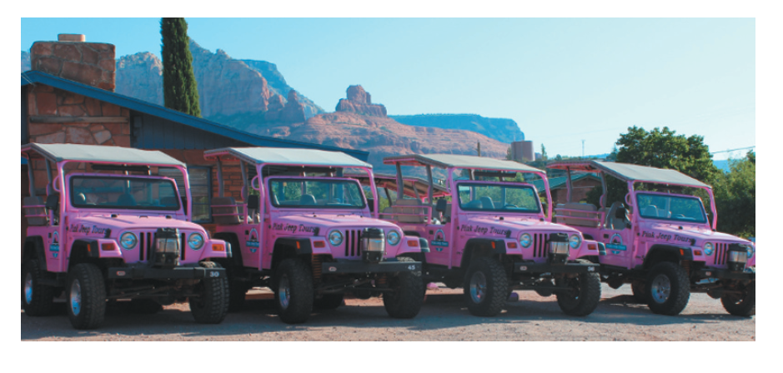
Pink Jeep Tours

